Slide 1
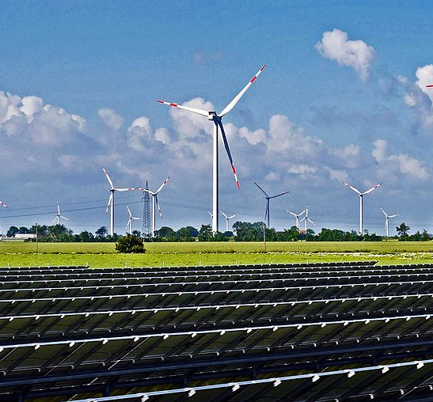
Here Comes the Sun:
Renewable Energy Production in California
Scott Clark
Graham Penrose
November 12, 2019

Slide 2
Project Goals
California has a goal of 33% renewable energy production by 2020, up from 20% in 2011.
What progress has been made?
What are the contributions from different types of renewable energy?
How does the time of year and time of day impact renewable production?
How do renewables contribute toward demand generally and during times of peak demand?

Slide 3
the data
Project Process
Data sources
California Independent System Operator (CAISO)
Annual production data
Kaggle
Aggregated renewable energy production dataset
U.S. Energy Information Administration (USEIA)
Demand data

Slide 4
Results
Project Process
Challenges
API access restrictions
Recent data availability

Slide 5
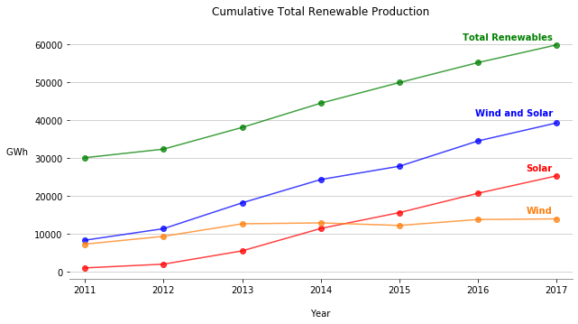
Renewable energy production doubled from 2011 to 2017, largely driven by increased solar production.

Slide 6
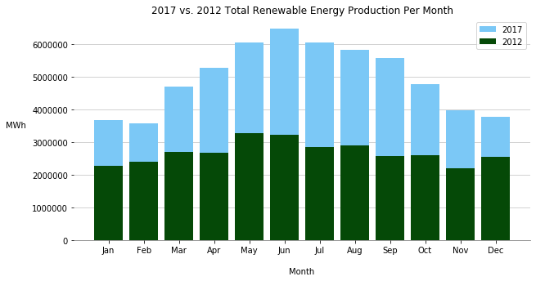
The largest increases in renewable production occurred during the sunnier months of the year.

Slide 7
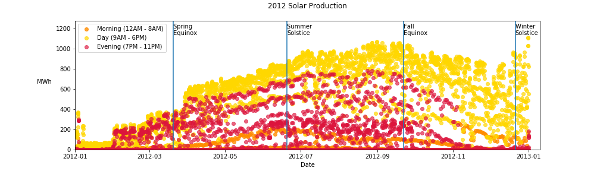
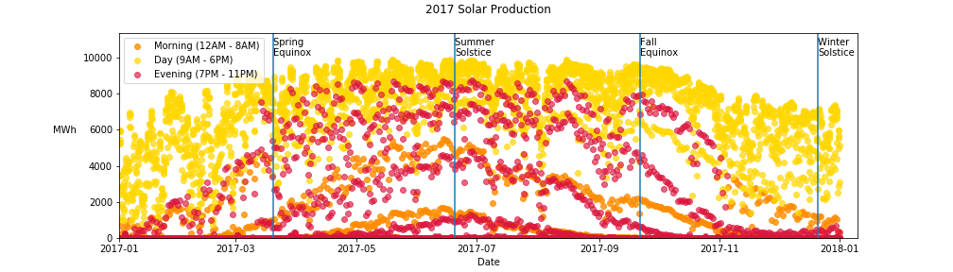
Solar production has greatly increased from 2012 to 2017 (note different scales).
Production varies by season and hour.

Slide 8
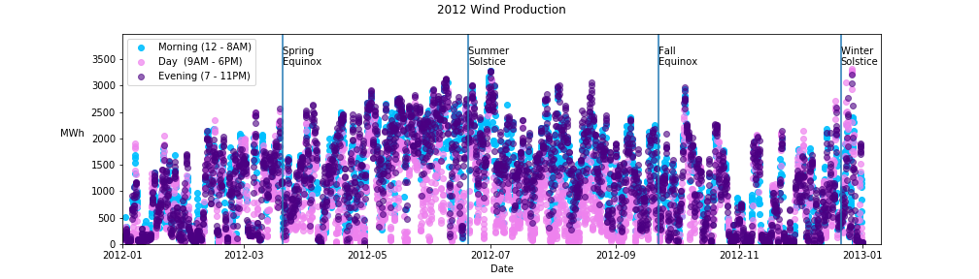
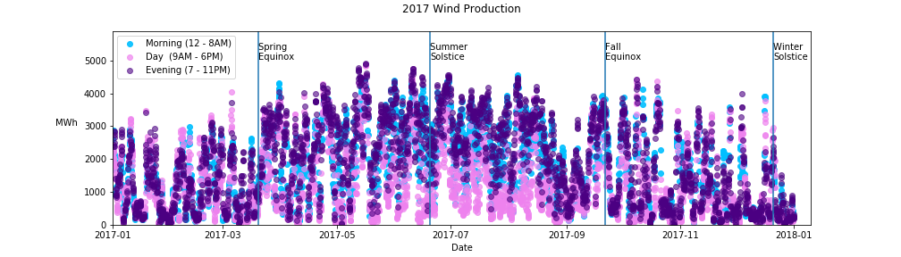
Wind production hasn’t seen the same growth as solar power.
Wind production also fluctuates by hour and season.

Slide 9
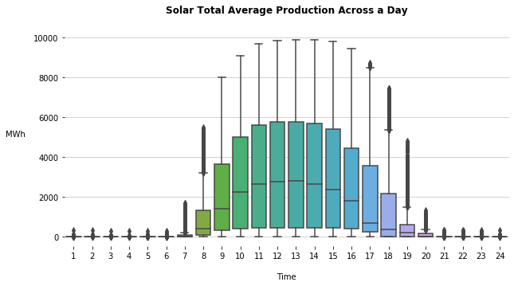
Daily production fluctuates for solar power based on daylight hours and sun intensity.

Slide 10
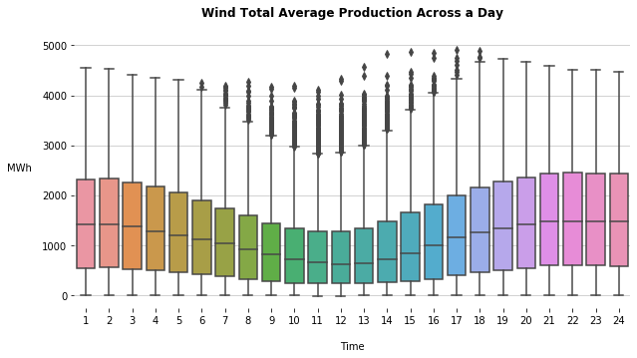
Wind power varies less and is most productive when solar is not.

Slide 11
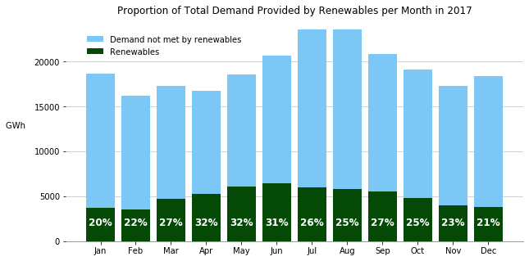
By 2017, California was close to the goal of 33% renewable energy production.

Slide 12
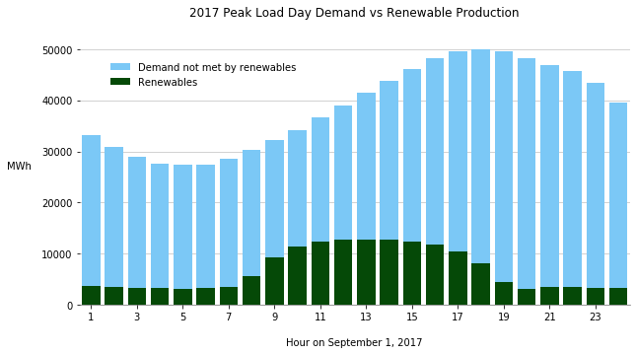
There is room for more solar contribution at time of peak energy demand.

Slide 13
Thank you
Aggregated renewable energy production dataset from Kaggle:
https://www.kaggle.com/cheedcheed/california-renewable-production-20102018
Annual production data from the California Independent System Operator:
http://www.caiso.com/Pages/default.aspx
Demand data from the U.S. Energy Information Administration:
https://ecdms.energy.ca.gov/elecbycounty.aspx

